Slide 1
Completing GLACIER Tax Prep (GTP)
This demonstration will walk you through the basic program. Depending on your personal information entered into the system you will be directed to provide more or different information. Read the screens carefully to determine what is required to be entered.
Enter your GLACIER account through the link provided in the email titled “Welcome to GLACIER Tax Prep,” if you forgot your login information click on Forgot Login
If you have questions while entering your information into GTP you can click on the “Help” option at the top of the screen in the blue area. This will provide general information regarding the questions on the screen, it will also provide an email link to ask for assistance from GLACIER. Answers are typically provided rather quickly depending on the time of day.

Slide 2
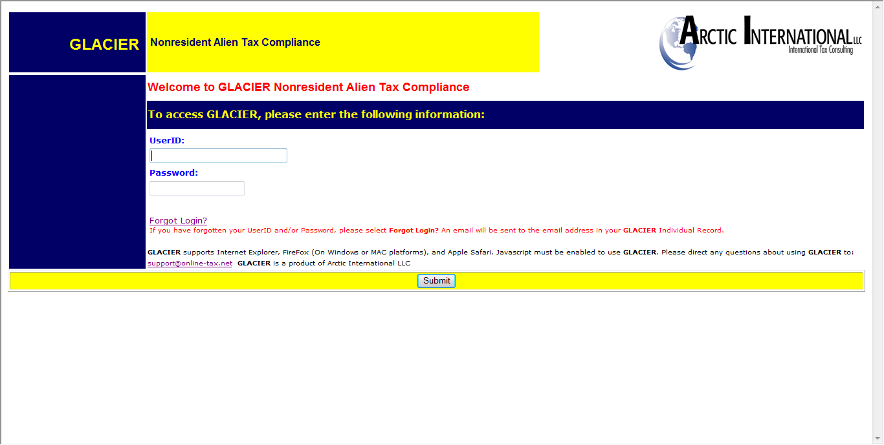
Enter login information and click on submit button

Slide 3
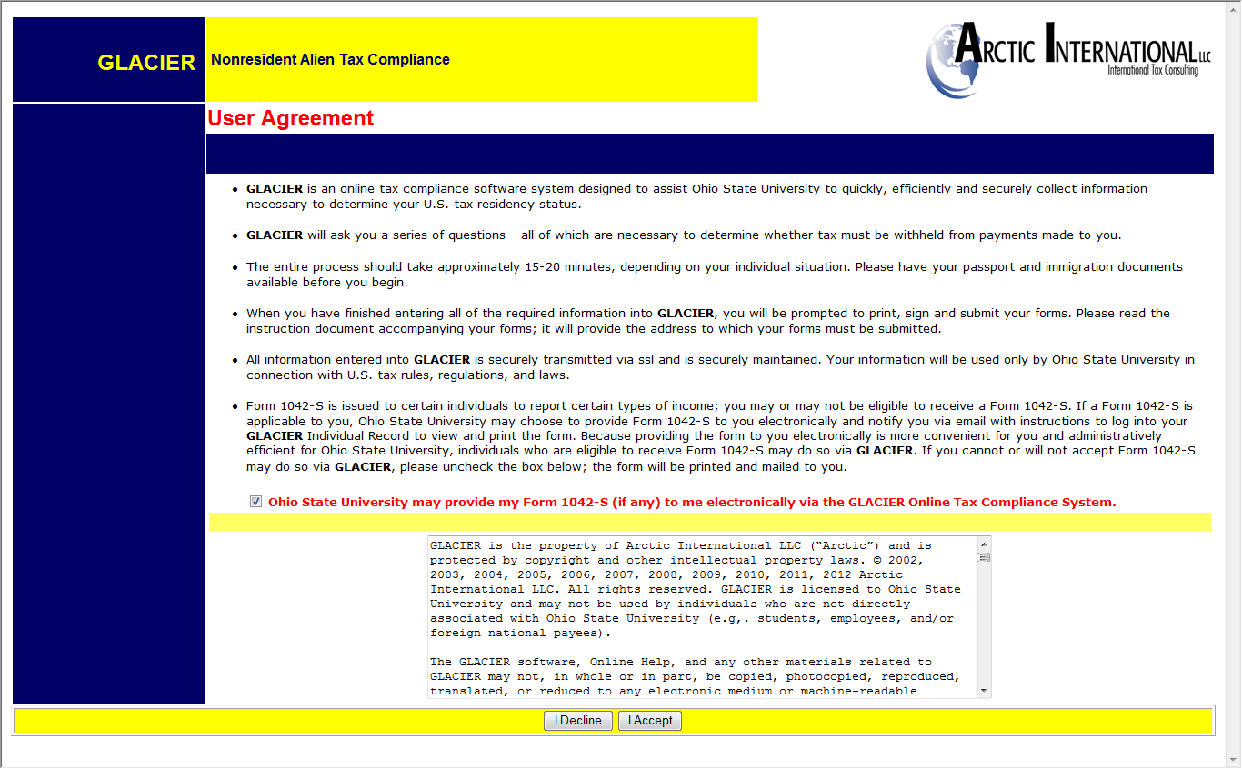
Check the box regarding 1042-S forms and click on the “I Accept” button to continue

Slide 4
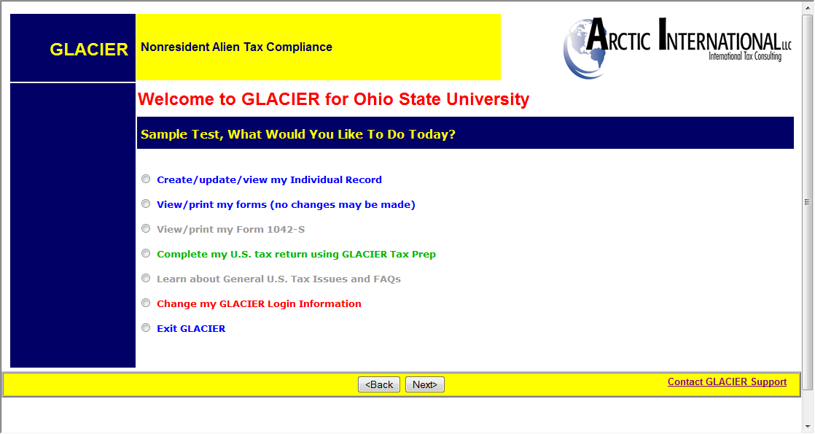
Select the option to ‘Complete my U.S. Tax return using GLACIER Tax Prep’ to complete a tax return

Slide 5
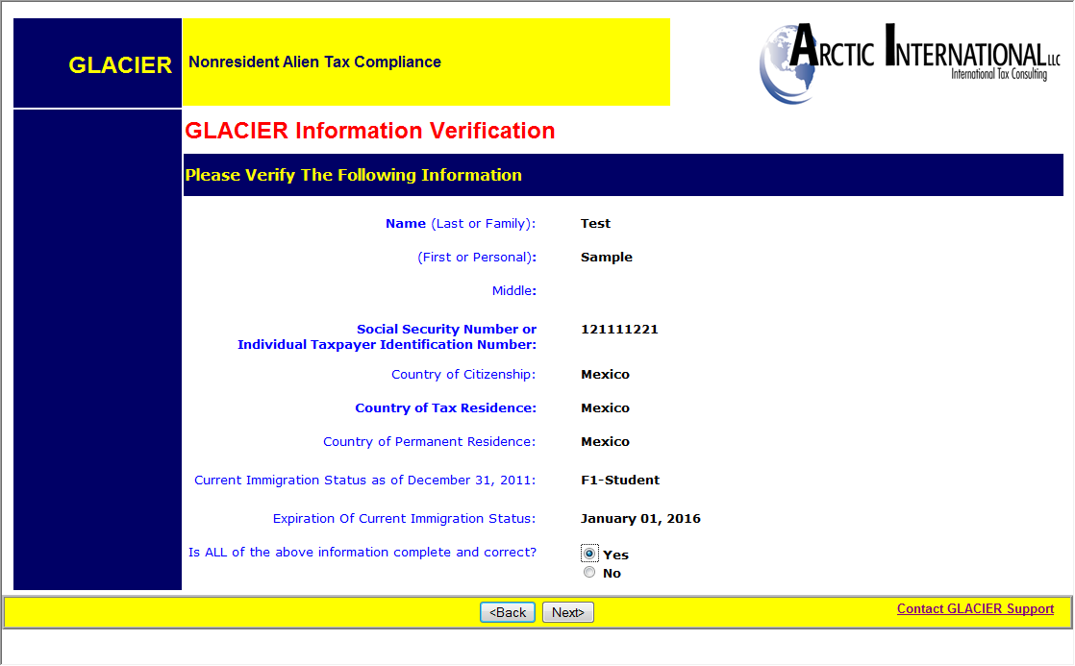
Verify that all the information is correct by selecting the Yes option and click on the next button

Slide 6
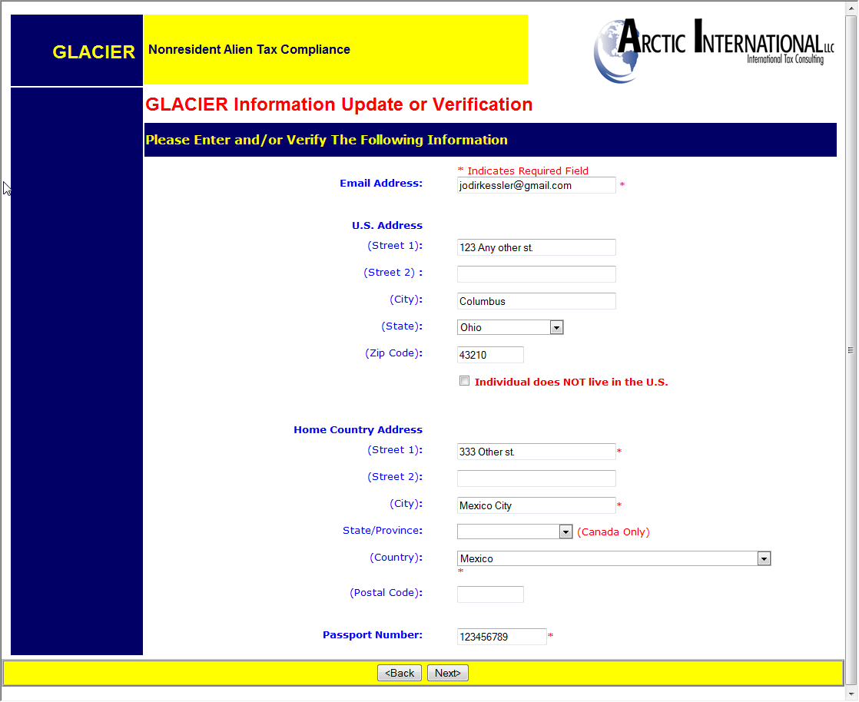
Update any information as needed and click on the next button

Slide 7
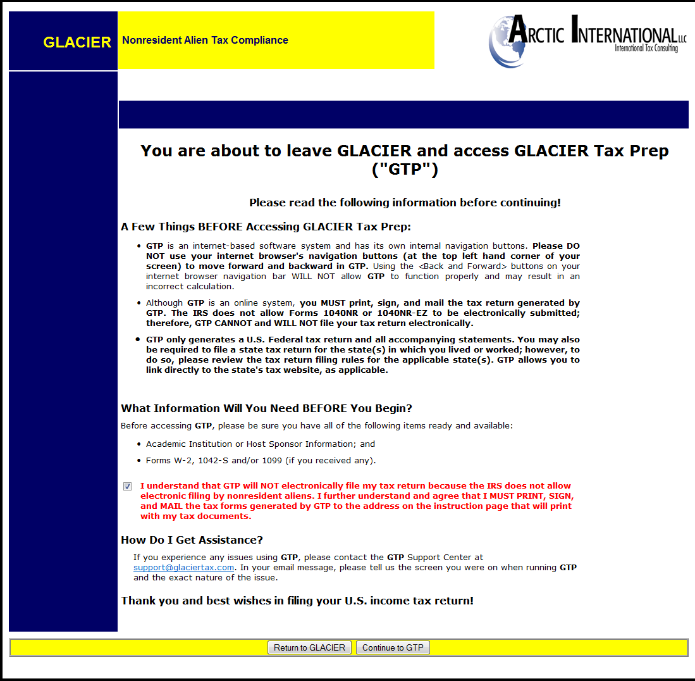
Check the box beside the warning that GTP will not electronically file the return, as the IRS does not allow it at this time, and click on Continue to GTP

Slide 8
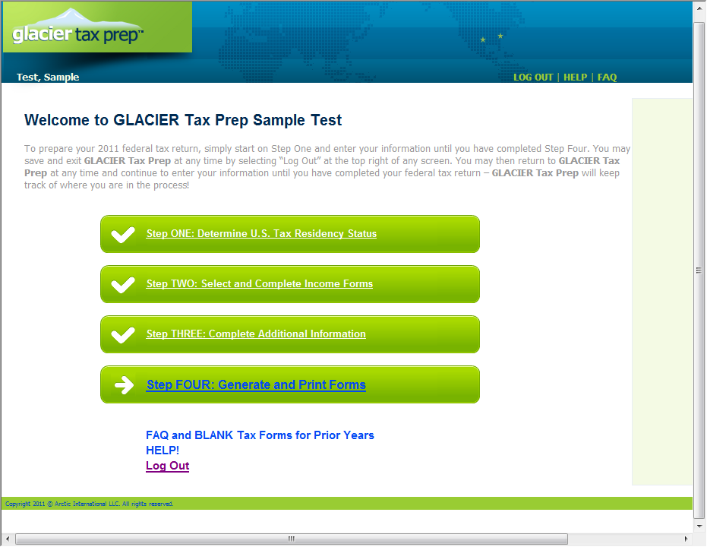
You will need to complete each step in GTP to generate your tax forms, start by clicking on Step One

Slide 9
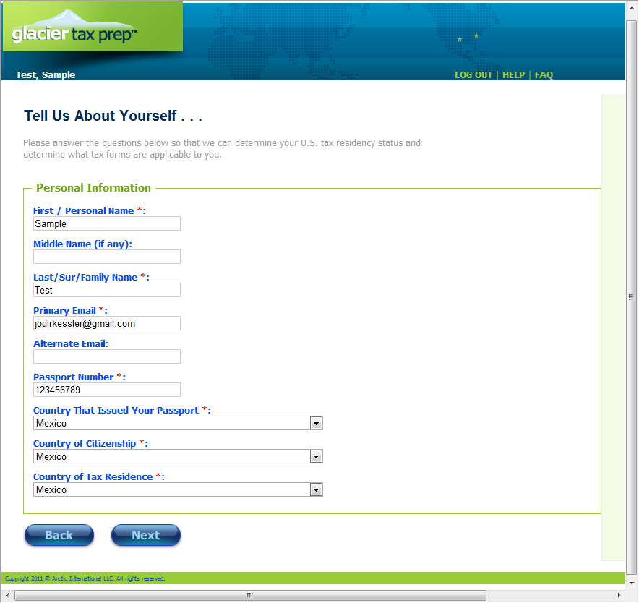
Enter in the request information and click on the Next button

Slide 10
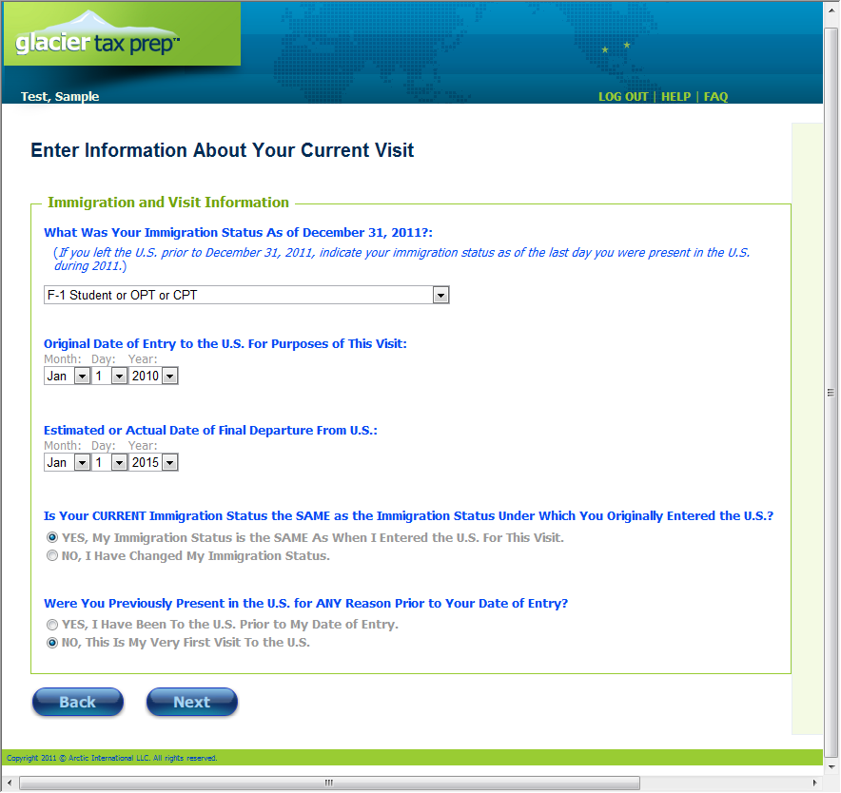
Enter the information regarding your immigration status and visits and click on the next button

Slide 11
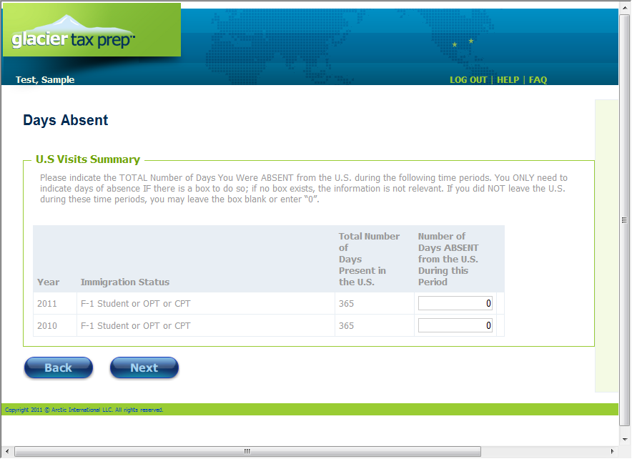
Enter any days that you were not in the U.S. during the years shown and click on the next button

Slide 12
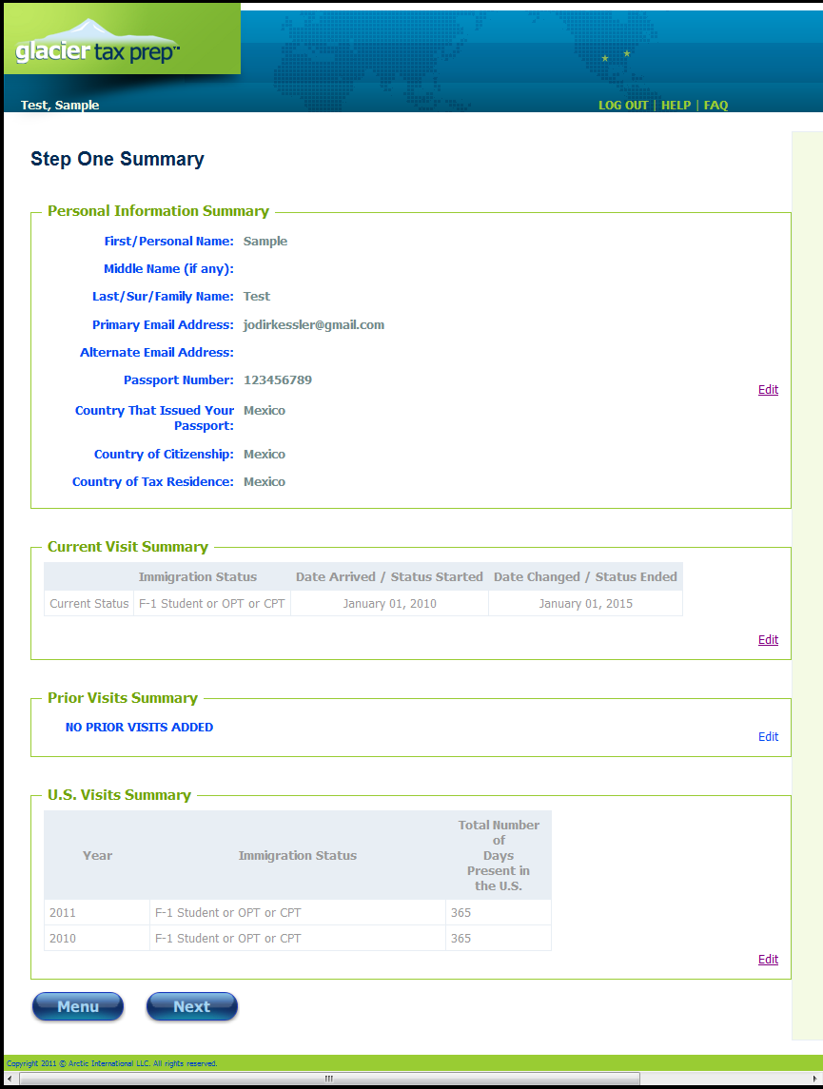
Make sure that all of the information on the summary page is correct before clicking on the next button

Slide 13
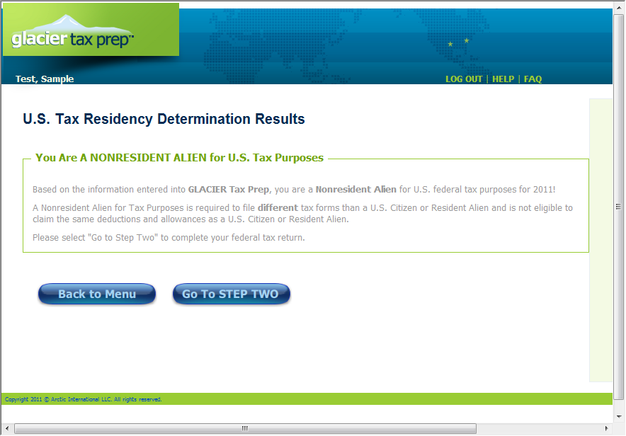
Based on the information you previously entered GTP will determine whether you are a nonresident or resident alien. Only nonresident aliens may continue to use GTP by clicking on the Go To Step Two button

Slide 14
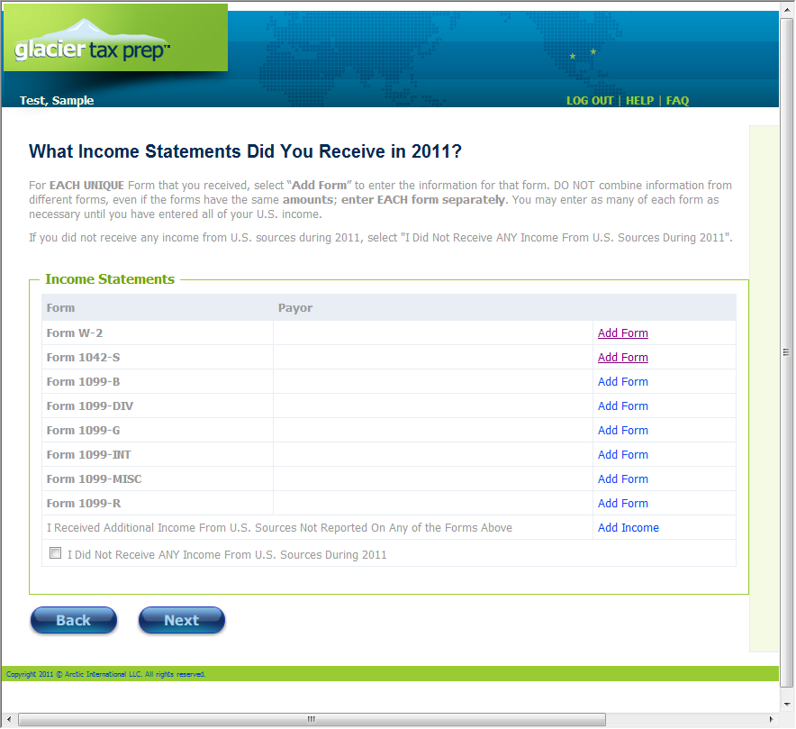
For each of the forms that you have received, you will need to enter in the information from those forms into GTP by clicking on ‘Add Form’ beside the type of form you received. You may add as many forms as needed if you received more than one of a particular type of form

Slide 15
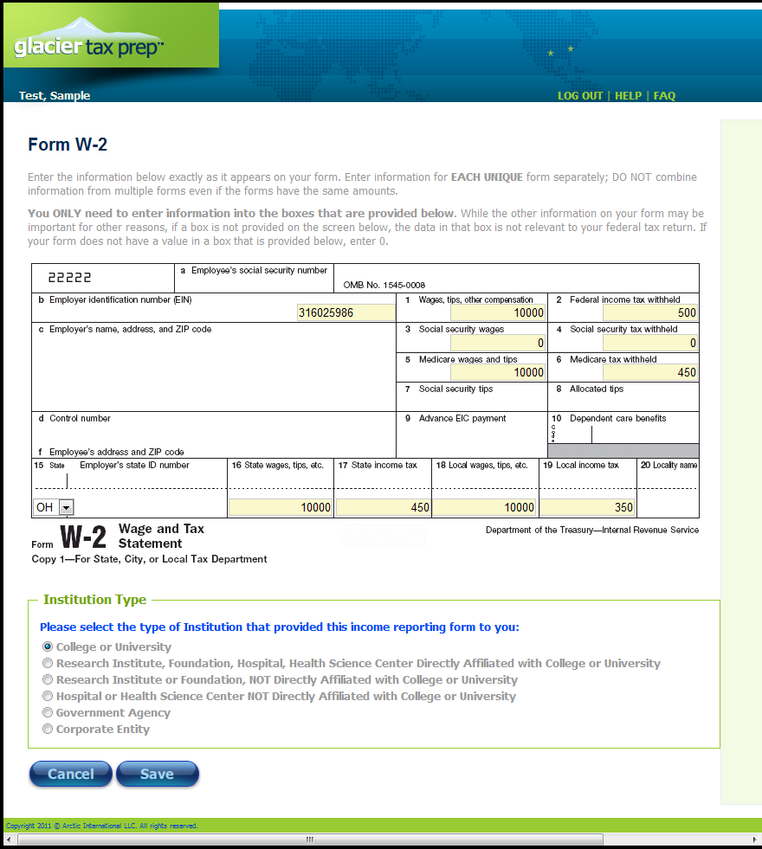
Example of the W-2 Form. You only need to enter the information in the available fields, make sure the numbers are exactly the same as those on your W-2 Form. Select the type of Institution you received the Form from and click on the Save button, which will take you back to the previous screen listing all available forms.

Slide 16
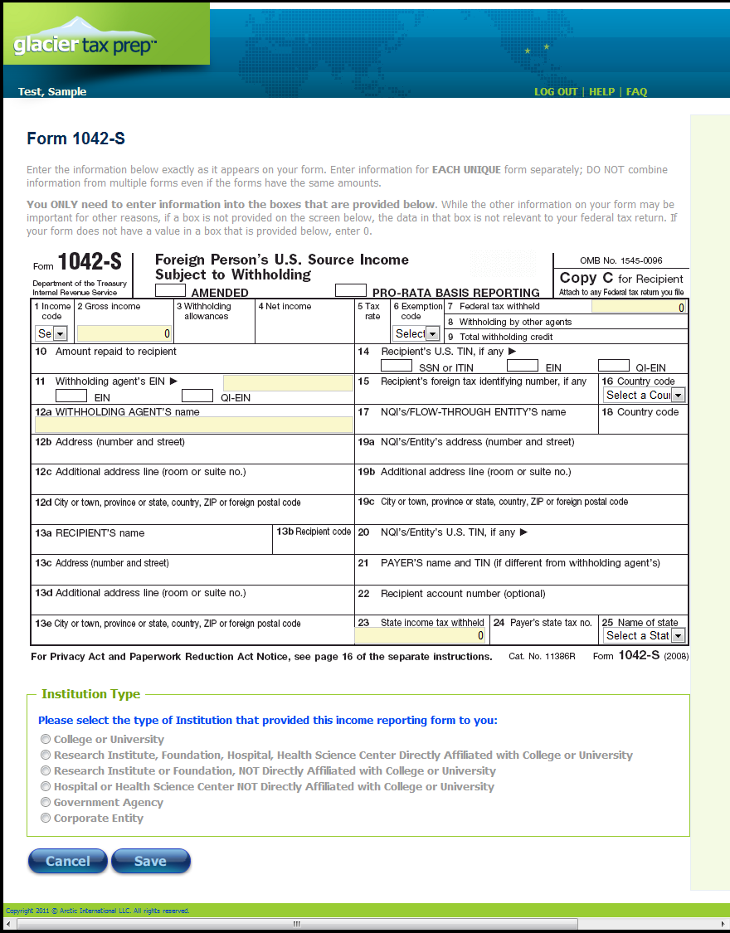
Example of a 1042-S Form. Fill in the fields required to exactly match the 1042-S you received. Select the type of institution you received the form from and click on the Save button, which will take you back to the screen listing all of the available forms.

Slide 17
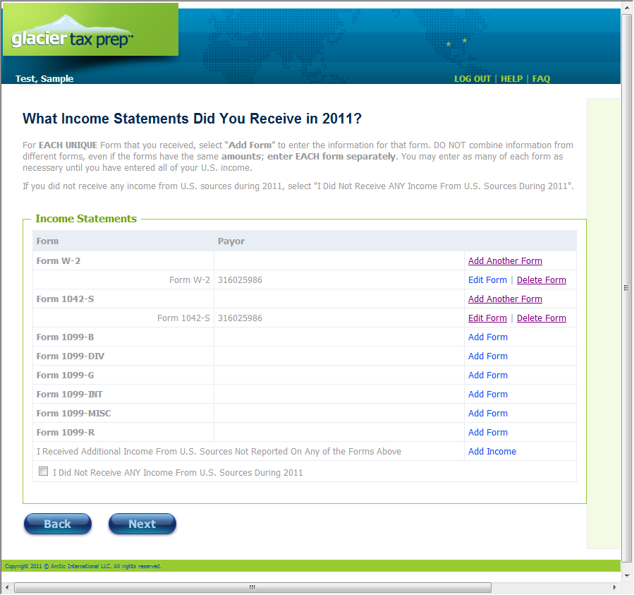
Once you have entered in the information from all of your forms select the next button to continue. If you did not receive income or only need to file Form 8843, click on the box “I did not receive any income…” and click on the next button

Slide 18
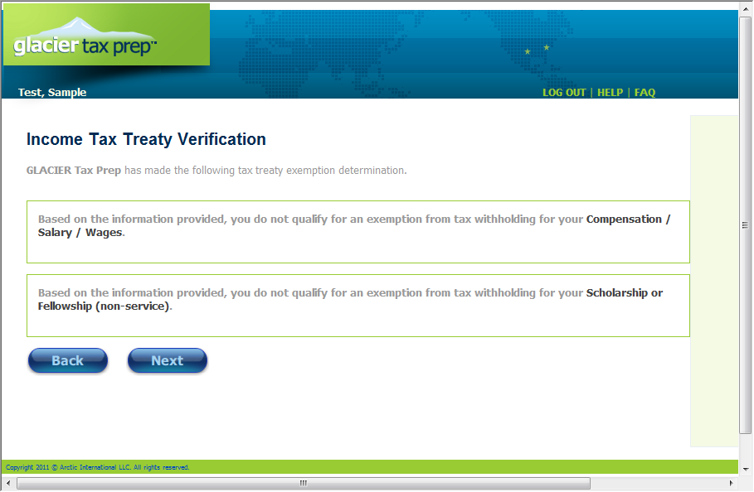
The summary page will tell you whether or not an Income Tax Treaty will apply to any of your income, click on the next button to continue

Slide 19
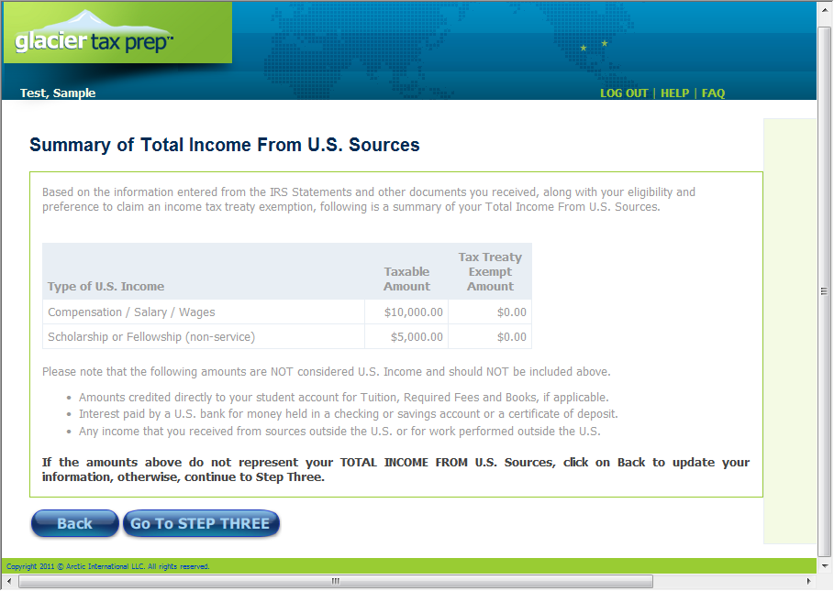
Summary page of Step Two, click on Go To Step Three to continue

Slide 20
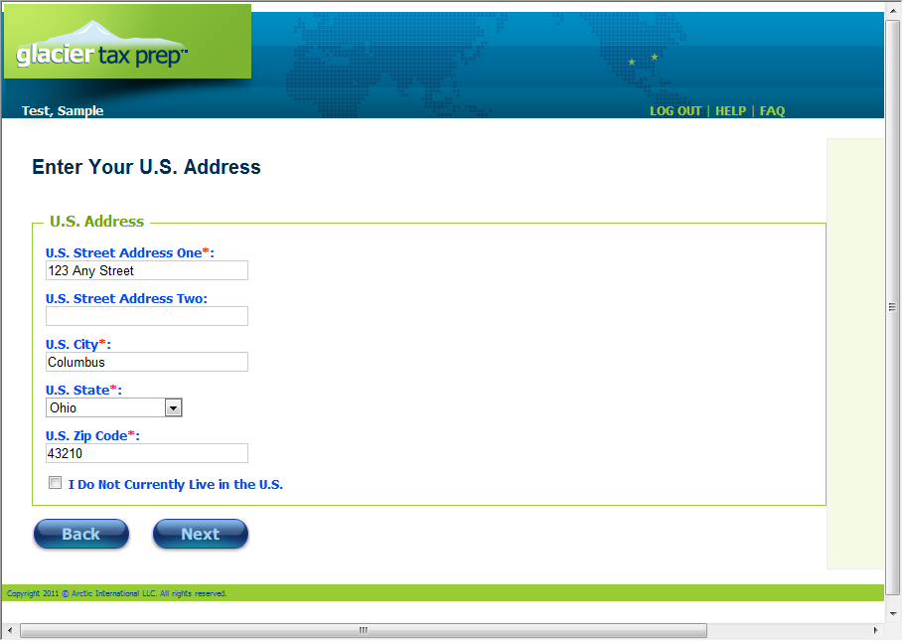
Update your U.S. address or click on the box if you do not have a U.S. address and click on the next button

Slide 21
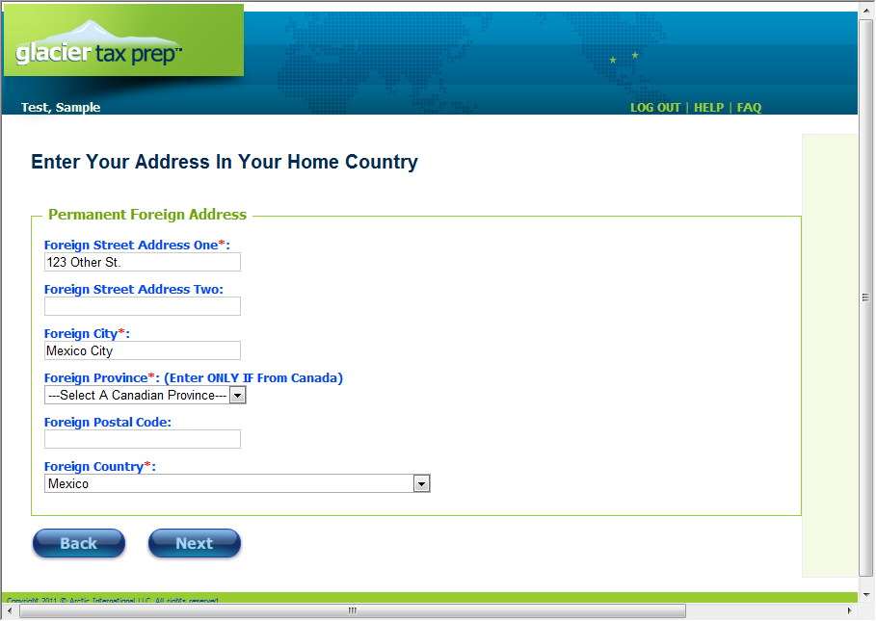
Enter your permanent address from your home country and click on the next button

Slide 22
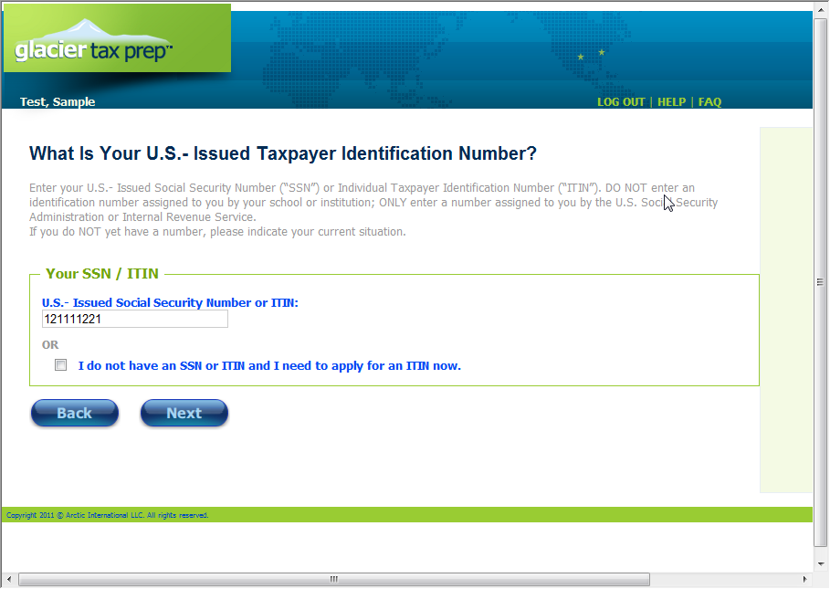
Enter your SSN or ITIN number, if you do not have one click on the box and you will be able to complete information that will create a W-7, application for an ITIN number that you can mail in along with your tax return

Slide 23
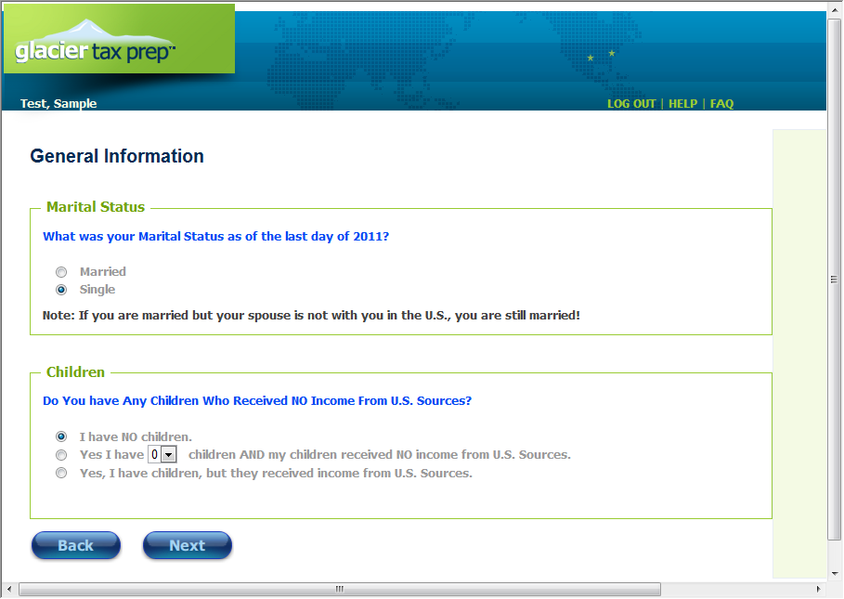
Enter the requested information and click on the next button

Slide 24
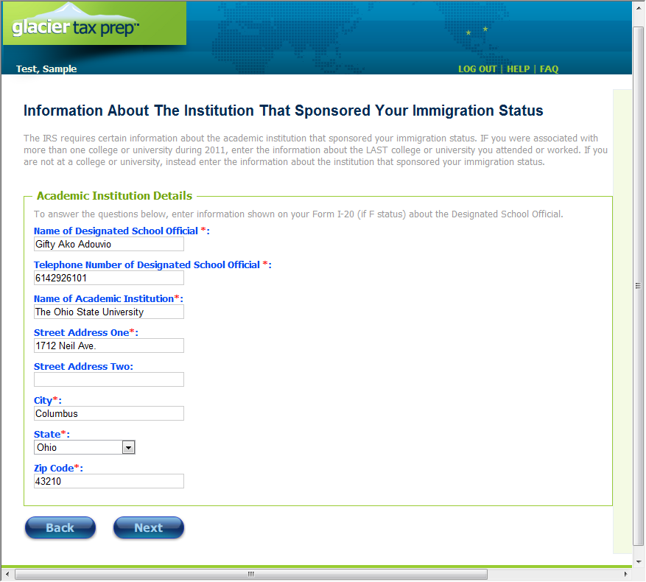
Enter the requested information. This information was in the ‘Welcome to GLACIER Tax Prep’ email, and is entered into the screen shown here.

Slide 25
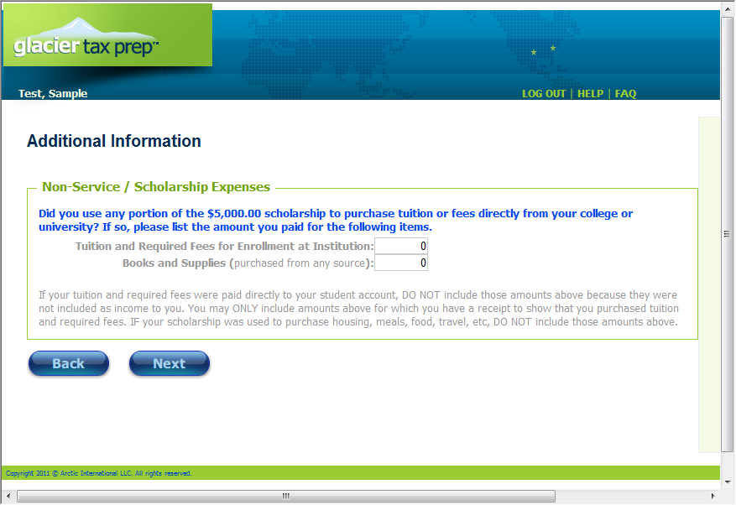
Enter in any amounts if this applies to you and click on the next button

Slide 26
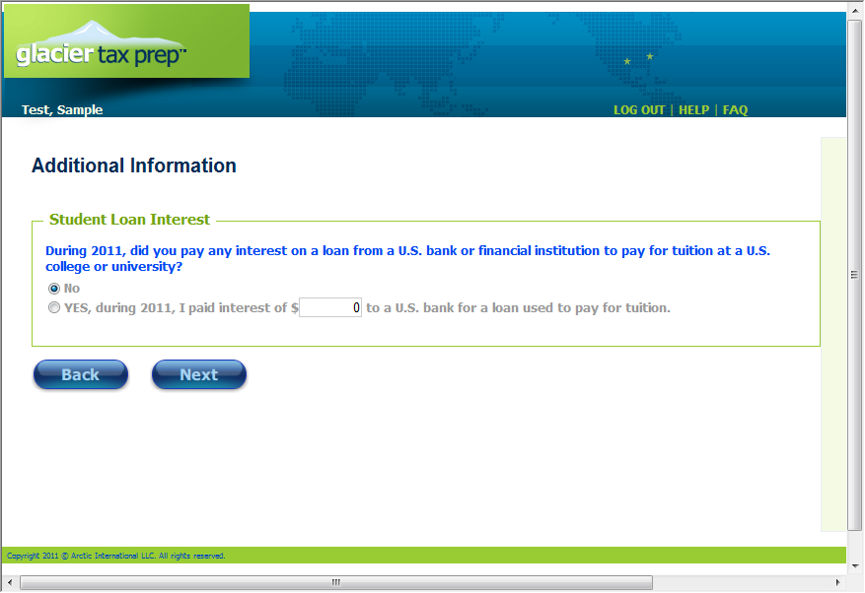
Enter amounts only if they apply to you and click on the next button

Slide 27
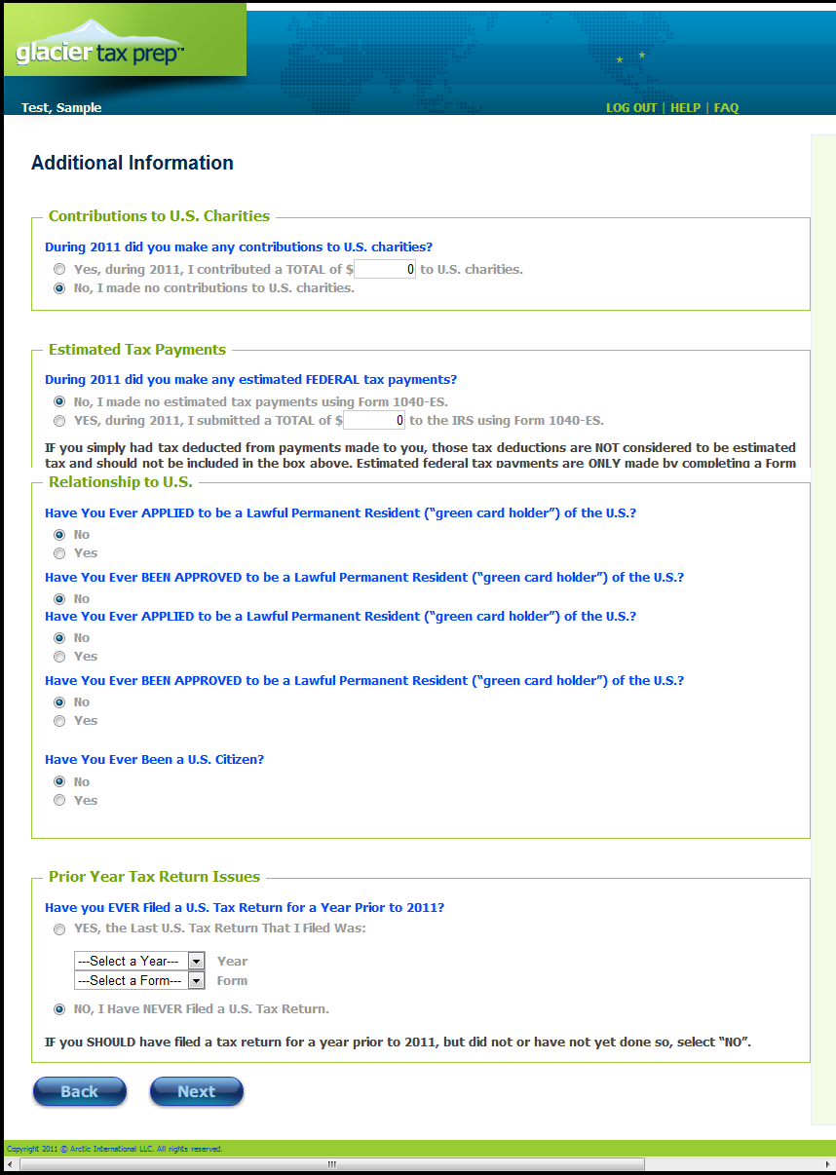
Enter the amounts and information requested as they apply to you. If you do not know what the question is referring to, chances are it does not apply to you, click on the next button when ready to continue.

Slide 28
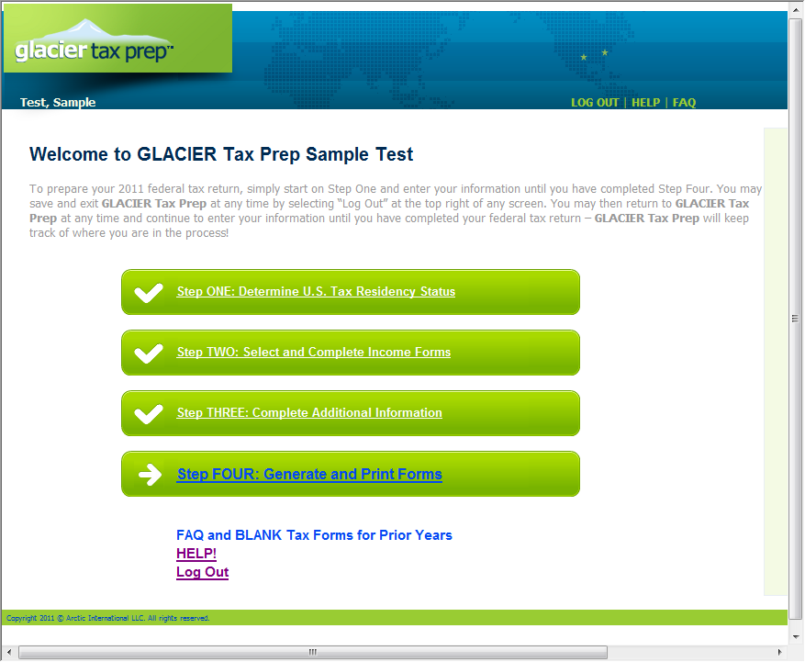
Once all your information is entered you will be able to select Step Four to print your completed tax forms

Slide 29
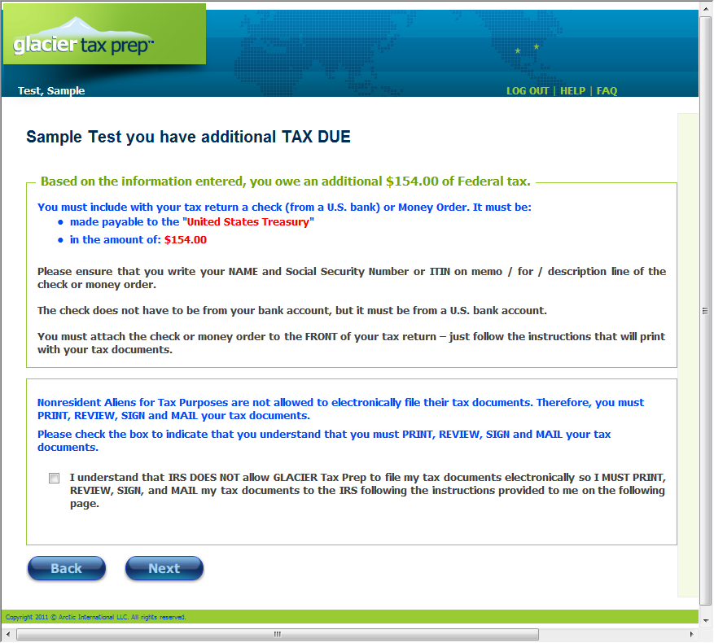
If you owe additional taxes you will see something like the screen below which includes payment instructions along with the reminder that you must print and mail in your tax returns.

Slide 30
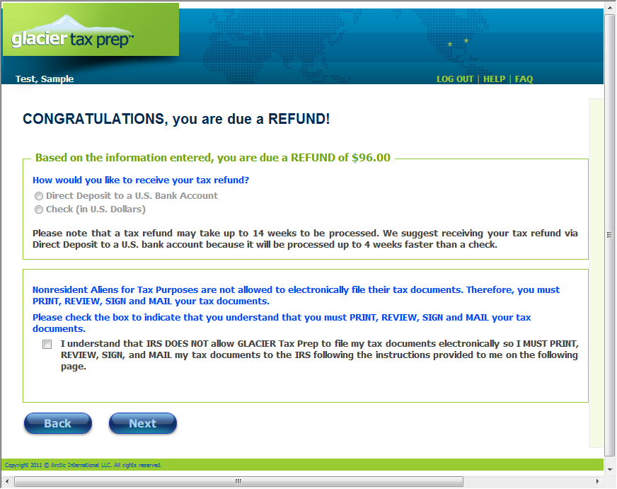
If you are due a refund of taxes withheld you will have the option to receive the money through a paper check mailed to you or through direct deposit into a US bank account. If you select direct deposit you will be directed to enter your account information. If you select Check you will be asked which address you would like the check mailed to.

Slide 31
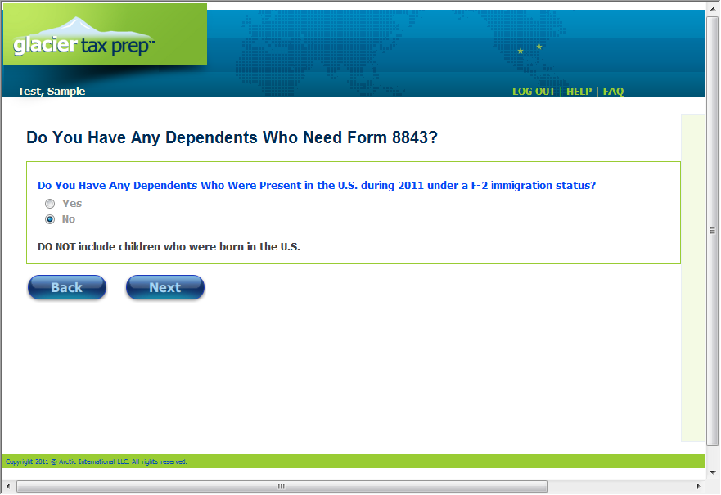
A separate form 8843 must be filed for each individual, so if you have any dependents with you in the U.S. you can select yes. You will then be directed to fill in information that will be used to generate the 8843 Forms for those individuals.

Slide 32
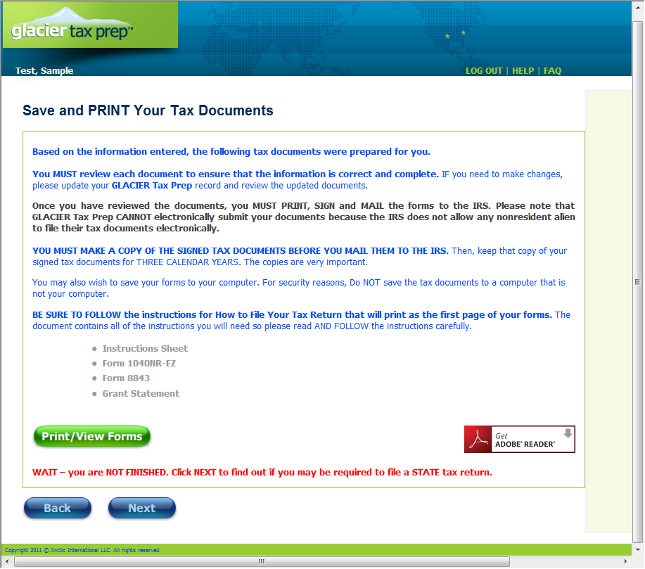
Click on the Print/View Forms button to print out and save your tax return forms. When finished printing click on the next button to determine any if you have any additional State filing requirements.

Slide 33
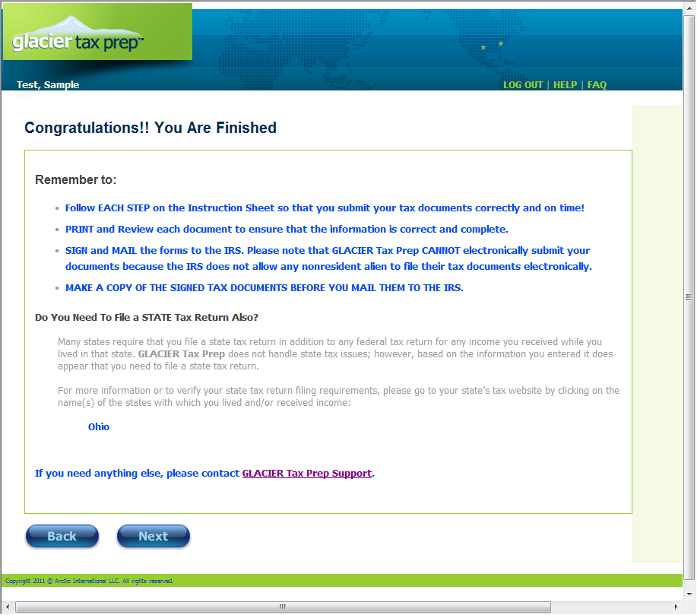
Carefully read the instructions presented. The bottom portion will help you determine whether you need to file a State Income Tax Return. If you are required to file a State Return it will provide a web link to the State page for filing instructions. Click on the next button when complete.

